Slide 1
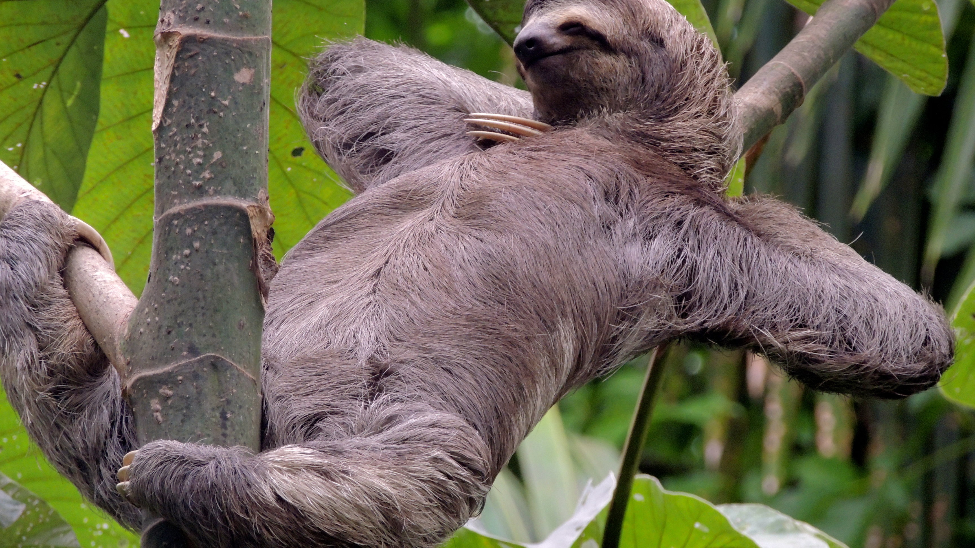
Mixed Effects Models
Joe Brehm, Mariel Boldis, Steven Bristow, and Janyne Little

Slide 2
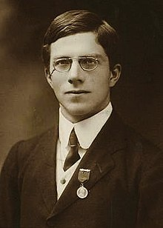
Types of Models
Fixed effects models
traditional regression
individual specific effects are correlated with the independent variables
Random effects models
introduced in the early 1900s by Ronald Fischer (1890-1962)
individual specific effects are uncorrelated with the independent variables
Mixed effects models
includes both fixed and random effects
Ronald Fischer: British statistician and geneticist

Slide 3

Advantages
Can handle missing values/unbalanced sample design (a drawback of ANOVA or rANOVA)
Deals with random effects– allows them to be properly specified and computed

Slide 4
Common uses
Repeated measurement studies
Example- measurements on plants over time
Where measurements are made on clusters of related statistical units
example- measurements on plants clustered in blocks
Other examples- quadrats in transects, counties in states

Slide 5
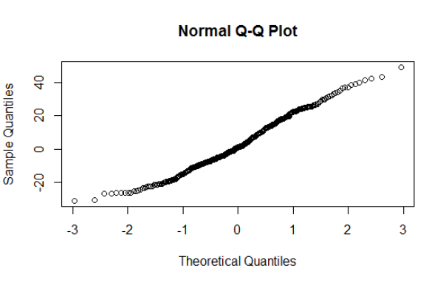
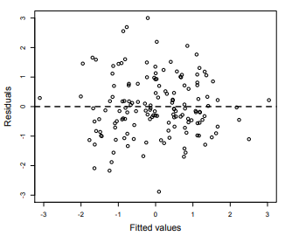
Assumptions
Normally distributed
Constant variance
*Measures are independent
*Data are linear (for linear mixed effects and generalized linear mixed effects models)

Slide 6
Fixed vs. Random
Fixed effects | Random effects
when one is interested in how a factor influences the response variable | when the effect is a source of variation that we are uninterested in but want to account for in our model.
data has been gathered from all the levels of the factor that are of interest | factor has many possible levels, interest is in all possible levels, but only a random sample of levels is included in the data
Can be categorical or continuous | Often categorical
Examples: temperature, water, nutrients | Examples: blocks, lakes, year

Slide 7
Fixed vs. Random Confusion
The same variables can be fixed OR random depending on the context
Example with “year”
If year is a replicate, it’s usually a random effect
If year is used in time series analysis it’s a fixed effect

Slide 8
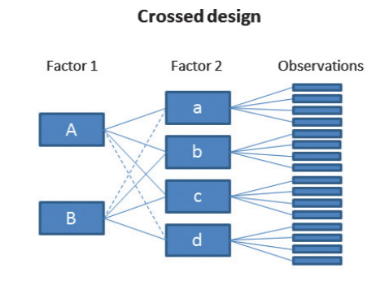
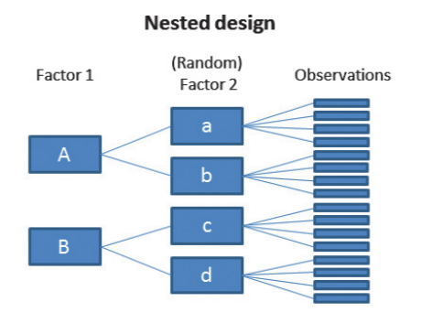
Factorial Structure
Mixed effects models have a hierarchical structure which can influence analysis
Crossed Design
All possible combinations of factors 1 and 2 are accounted for
Nested Design
Some instances of factor 2 exist only within factor 1
Notes:
https://besjournals.onlinelibrary.wiley.com/doi/pdf/10.1111/j.2041-210x.2012.00251.x

Slide 9
Interaction Effects
If you expect that the combination of main effects will have different responses than the main effects overall
Example- each variety of a species will respond to a watering treatment differently
With linear models, if an interaction is significant you cannot interpret the main effects and instead ought to interpret the interaction effect

Slide 10
Example 1
Bodo Winter is interested in the differences in voice pitch as a response to politeness. His research team has surveyed 18 participants (9 male and 9 female) and asked them a series of questions each day for several days and recorded the pitch.
What are the fixed and random effects?

Slide 11
Example 2
A researcher is interested in the effects of land use and species richness on carbon sequestration. They have conducted a survey of 10 sites, measured number of species in each site, the land use for that site, and the amount of carbon sequestered.
What are the fixed versus random effects? Interactions?

Slide 12
Example 3
A researcher is interested in the different productivities of 3 cultivars of soybean as well as the optimal amount of water (3 levels) for those different cultivars. The researcher conducts the experiment for two consecutive years in order to increase replicates. Each year, “productivity” is measured at weeks 3, 6, and 9. All genotype and water combination are combined into 4 different blocks.
What are the random and fixed effects? Interactions? Hierarchy?

Slide 13
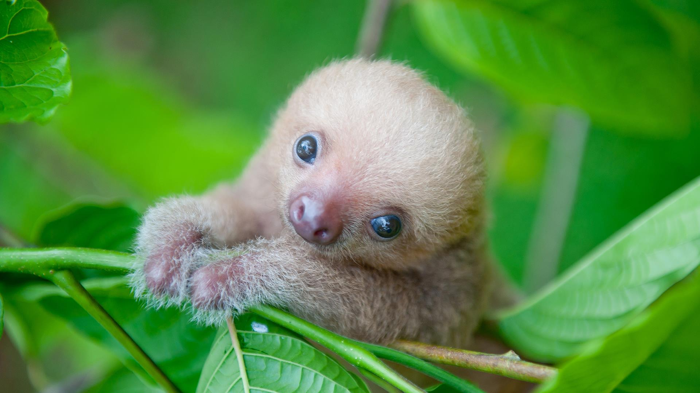
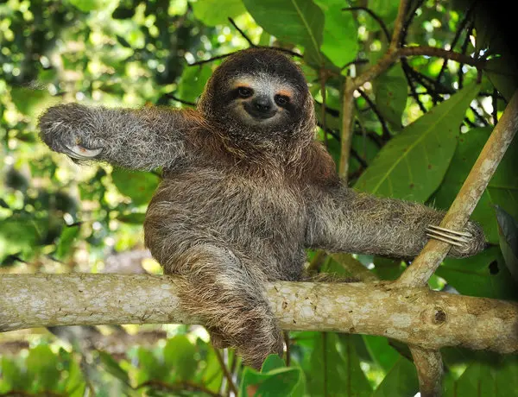
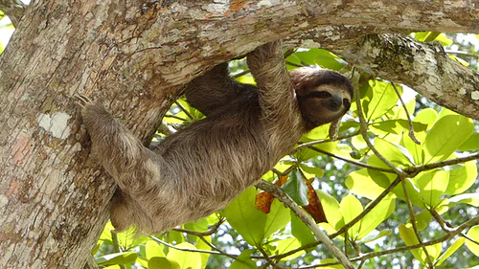
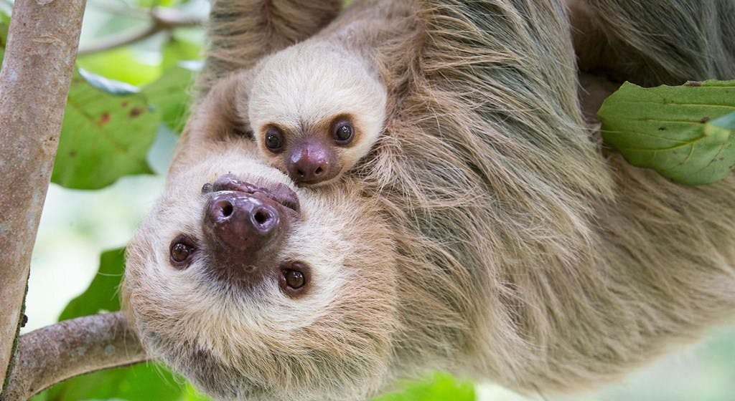
Sloths

